Slide 1
CHAT ROOM
USING HTML, PHP, CSS, JS, AJAX
Mini- Project
Project by:
Amey Mahendra Thakur | Karan Sukhvinder Dhiman

Slide 2
Introduction
This mini project is an example of a chat server. To start chatting, clients should get connected to a server where they can practice two kinds of chatting, public one (message is broadcasted to all connected users) and private one (between any 2 users only) and during the last one security measures were taken.
Teleconferencing or Chatting, is a method of using technology to bring people and ideas "together" despite geographical barriers. The technology has been available for years but the acceptance it was quite recent.

Slide 3


Slide 4
Problem Statement
Develop an application which facilitates creation of a chat room with a live server for the users to enable sharing messages or chat on the go.
Develop an instant messaging solution to enable users to seamlessly communicate with each other and also which can be used by any novice user. I.e. Live chat room on the fly (online).

Slide 5
Problem Solution
Our goal is to create a way to use technology to bring people and ideas together despite geographical barriers.
So, The Chat Room as a service is a model of communication deployment where the server hosts a live chat room as a service for users on the Internet.
It is a simple Web-Based Chat Application using php, mysql, javascript, ajax.
The project has been created keeping in mind the fact that the anonymity of the users will not be compromised under any circumstances.

Slide 6
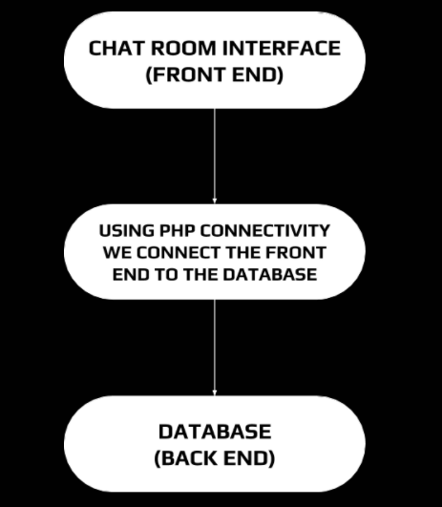
Flow Diagram

Slide 7
Implementation & Papers
GitHub Repository: https://github.com/Amey-Thakur/CHAT-ROOM
Pre-print @arXiv: https://arxiv.org/abs/2106.14704
Published Paper @IRJET: https://www.irjet.net/archives/V8/i6/IRJET-V8I6348.pdf

Slide 8
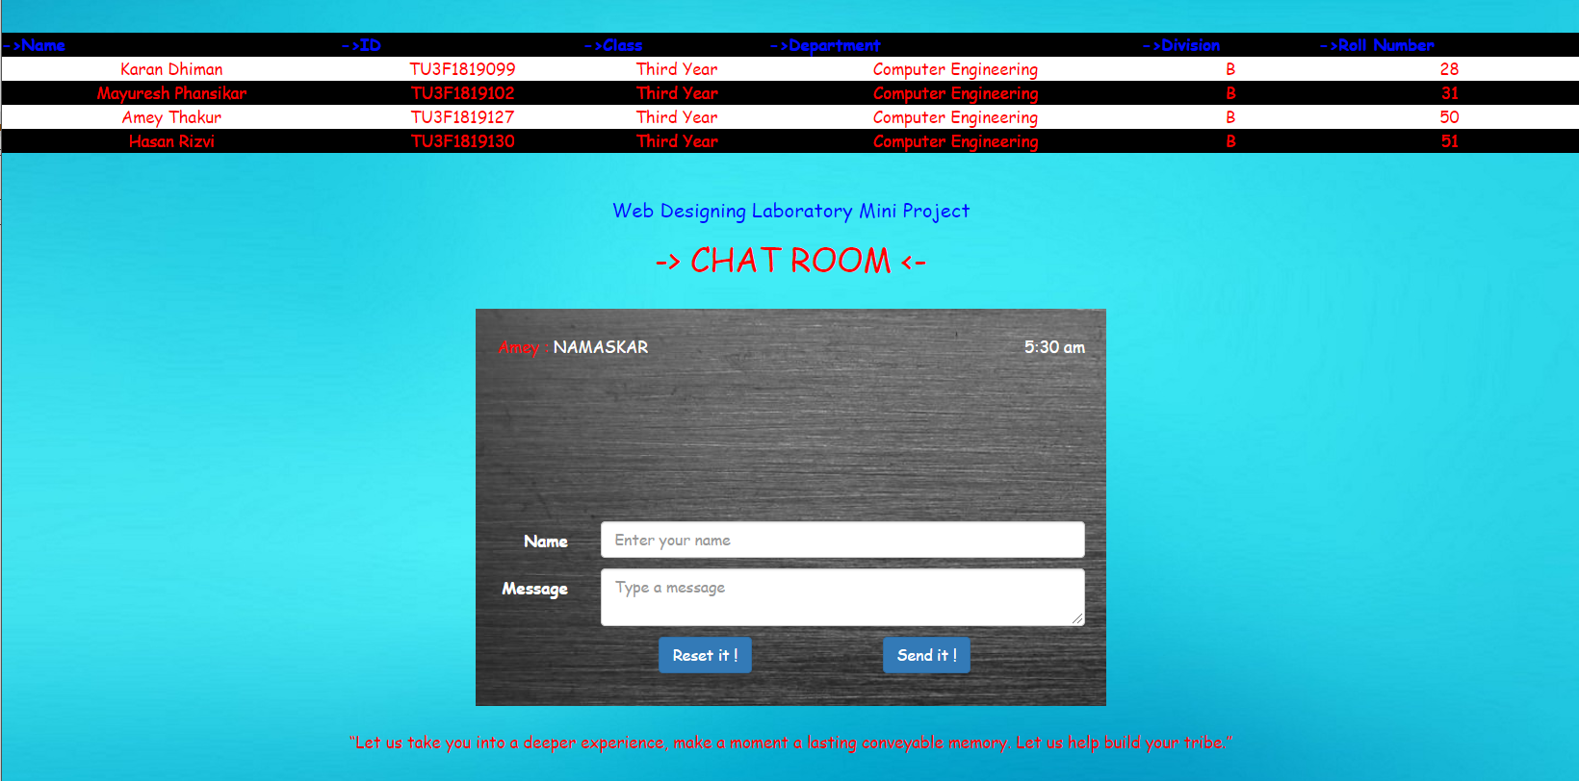
User Interface

Slide 9
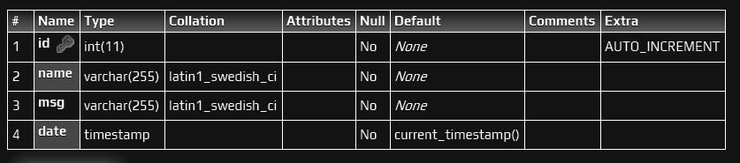
Database > Table > Structure

Slide 10
System Requirements
To be used efficiently, all computer software needs certain hardware components or other software resources to be present on a computer.
Various categories are:
Hardware Requirements - Keyboard, Mouse, Monitor, Wireless Peripherals, Smartphone
Software Requirements - XAMPP, GitHub, Web Browser
Functional Requirements - Sending message, broadcasting message
Non-functional Requirements - Security, Performance Time, Error Handling, Availability, Ease of use

Slide 11
Project scope and features
Chat Server Application is going to be a text communication software, it will be able to communicate between two computers using point to point communication.
Anonymity is the key feature of this project.
The limitation of our project is that it doesn’t support audio conversations.
Companies would like to have a communication software wherein they can communicate instantly within their organization.
The fact that software uses an internal network within the organization makes it very secure from outside attacks.

Slide 12
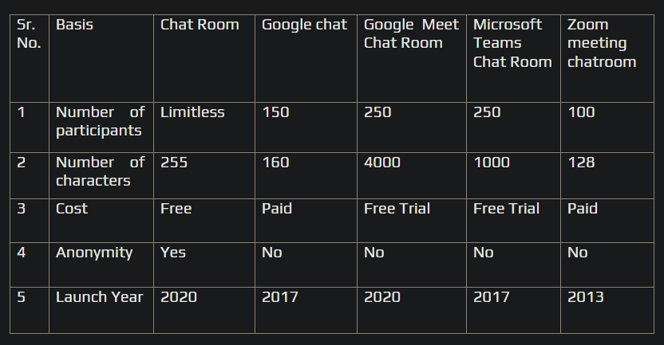
Comparison of Chat Room System with Previous system

Slide 13
Conclusion
Here, we have built Simple Web-Based Chat Application using php, mysql, javascript, ajax.
There's always room for improvements in any product, and we have tried to adapt the design accordingly, while also keeping track of our limitations.
We hope our idea was clear and well presented with the final output for it.

Slide 14
THANK YOU

